Slide 1
Evaluation Metrics
Confusion Matrix

Slide 2
Resampling Methods
Validation Set Approach
Sekian persen data menjadi data validation (80%, 10%, 10%)
Kekurangan: Jumlah data train berkurang.
K-Fold Cross Validation Approach
Data train dibagi menjadi beberapa fold, setiap fold berpeluang menjadi train & valid.
Bootstrap Approach
Random sampling with replacement dari data train (sampel).
Error terdistribusi normal (penting pada LinearRegression).

Slide 3

k-Fold Cross Validation
Model terbaik → CV score terbaik
Notes:
1 split = 1 model
CV Score: average performa/error dari seluruh split.

Slide 4
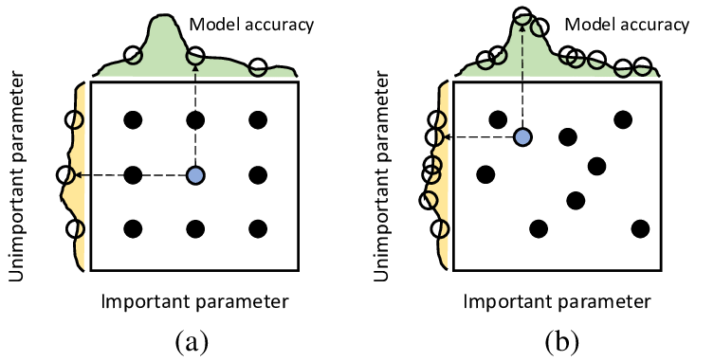
Cross Validation + Hyperparameter Tuning
GridSearchCV RandomizedSearchCV

Slide 5
Cross Validation + Hyperparameter Tuning
GridSearchCV
Evaluates every possible combinations of hyperparameter values & get the best combination.
Good for relatively few combinations.
Guarantees finding the best combination.
RandomizedSearchCV
Evaluates a fixed number of combinations, selecting a random value for each hyperparameter at every iteration.
Does not guarantee finding the best combination, but generally more efficient in large spaces.
Notes:
Tips: Use random search first to identify promising regions, then apply grid search within those more focused ranges.

Slide 6
Poin Penting
Pahami cara membangun Decision Tree dan cara prediksinya pada kasus klasifikasi dan regresi.
Pahami cara evaluasi model regresi dan klasifikasi, serta intuisi berbagai metriknya.
Pahami konsep Confusion Matrix saat mengevaluasi model klasifikasi.
Pahami konsep Cross Validation untuk tuning model.

